Slide 1
MINING User behaviors in social networks
Meng Jiang
www.meng-jiang.com

Slide 2
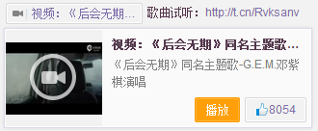


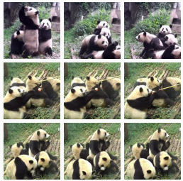
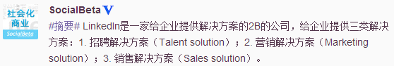
Why Do User Behavior Mining?
User-centric apps give us user behavioral data
User behaviors bring new problems and new apps

Slide 3
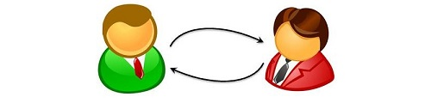
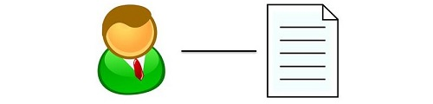


Behavior = Intention + Link
 | Influence mining Community detection Friend recommendation | Behavior prediction Recommendation Behavior pattern discovery
 | Fraud detection Zombie follower detection Suspicious friend requests | Spam detection True/False news Promoting behavior pattern
User-user link
User-item link
Normal use
Anomalous use

Slide 4
Challenging: Social Networks and Users
Large-scale
Relational
Heterogeneous
Complex (intention)

Slide 5
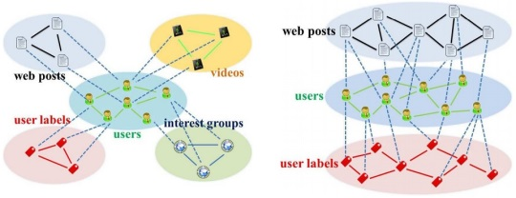
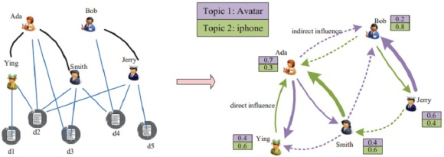
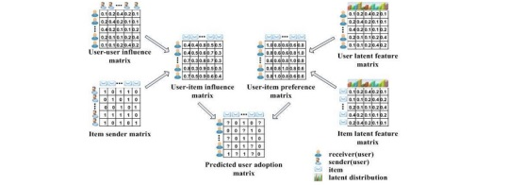
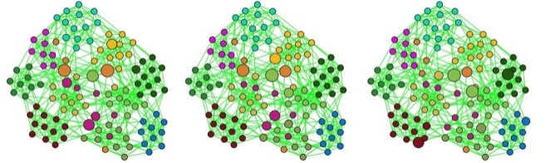
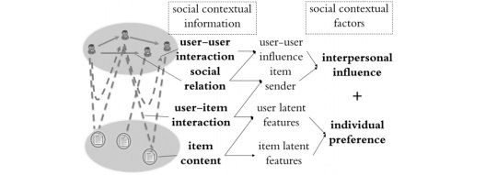
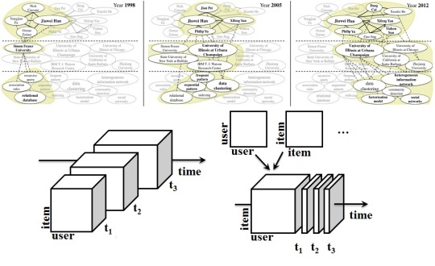
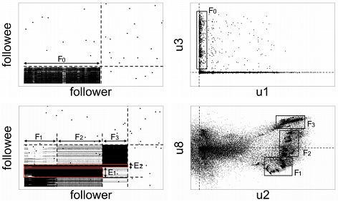
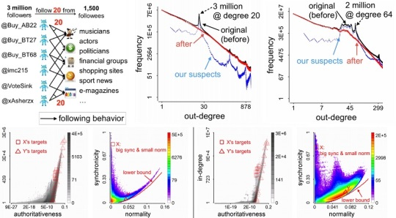
My Works in Mining User Behaviors
User-user link
User-item link
Normal use
Abnormal use

Slide 6
To Be Introduced Today
Social contextual recommendation [CIKM’12+TKDE’14]
Cross-domain social recommendation [CIKM’12]
Behavior discovery and prediction [KDD’14]
Dense bipartite core detection [PAKDD’14]
Fraudulent behavior detection [KDD’14]
Good user-item links
Bad user-user links

Slide 7
Normal Use + User-item Link
User-user link
User-item link
Normal use
Abnormal use

Slide 8


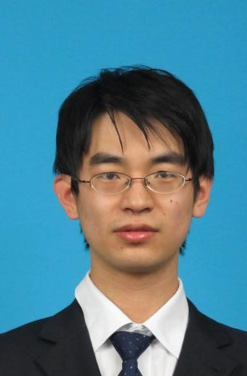

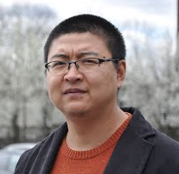
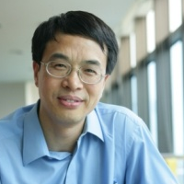

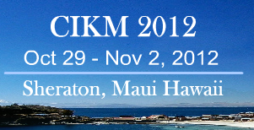
Social contextual recommendation
Meng Jiang
Joint work with Peng Cui, Rui Liu, Qiang Yang,
Fei Wang, Wenwu Zhu and Shiqiang Yang
October 30, 2012 – Maui, HI, USA

Slide 9
Recommender Systems
Predict missing “user-item” links
Predict missing values in “user-item” matrix
Challenge:
High sparsity
Bob
Amy
Tom
Nick
 | Amy | Bob | … | User M
Post 1 | 1 | 1 | … | 0
Post 2 | ? | 0 | … | ?
… | … | … | …
Post N | 0 | ? | … | 1
Post 1
Post 3
Post 2

Slide 10
Our Goals
Given: Links on social networks
Find: A social recommendation framework that best fit users’ adopting behaviors
Goals:
G1. Understand user intention of adoption
G2. A framework for social recommendation
G3. Predict the missing “user-item” links

Slide 11
Outline
1. Background
2. Understanding Intention
3. The Framework
4. ContextMF Algorithm
5. Experiments

Slide 12
Links on Social Networks
Target: “user-item” links
Nature: “user-user” links
Can social relation help?
How to use social contextual information?
Bob
social relation
Amy
Tom
user-user
interaction
Nick
user-item
interaction
item content
Post 1
Post 3
Post 2

Slide 13
Related Works
Content-based filtering
Collaborative filtering
Bob
Amy
Tom
Nick
user-item
interaction
item content
Post 1
Post 3
Post 2

Slide 14
Related Works
Content-based filtering
Collaborative filtering
Trust-based recommendation
Influenced-based recommendation
Bob
Amy
Tom
user-user
interaction
Nick
user-item
interaction
Post 1
Post 3
Post 2

Slide 15
Related Works
Content-based filtering
Collaborative filtering
Trust-based recommendation
Influenced-based recommendation
Social recommendation with MF/Social Regularization
Bob
social relation
Amy
Tom
Nick
user-item
interaction
item content
Post 1
Post 3
Post 2

Slide 16
Related Works
Can we fully use social contextual information?
Q: “Large-scale”? A: “Relational”!
Q: “Relational”? A: “Intention”!
 | Social relation | User-user interaction | User-item interaction | Item content
Content-based & CF | × | × | √ | √
Trust & Influence | × | √ | √ | ×
SoRec & SoReg | √ | × | √ | √
? | √ | √ | √ | √

Slide 17
Outline
1. Background
2. Understanding Intention
3. The Framework
4. ContextMF Algorithm
5. Experiments

Slide 18
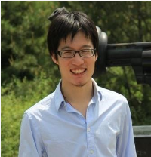
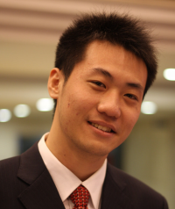
User Intention of Adopting Messages
Peng Cui : Is there anyone who call for paper via Renren? Hah!
http://media.cs.tsinghua.edu.cn/~multimedia/cuipeng/IR_SI_SocialMedia.htm
2011-01-05 13:47 Reply | Share
Call for paper? About social media? Wow!
Personal Preference
This is my best friend and co-author!
Interpersonal influence
Meng Jiang : Support! //Peng Cui : Is there anyone who call for paper via Renren? Hah!
http://media.cs.tsinghua.edu.cn/~multimedia/cuipeng/IR_SI_SocialMedia.htm
2011-01-05 14:05 Reply | Share

Slide 19
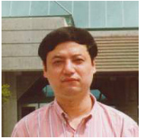
User Intention of Adopting Messages
Maosong Sun : KDD Summer School on Mining the Big Data will be held in Tsinghua. This is the first time for KDD to hold Summer School. Dean Xiaoyong Du, Dr. Hang Li and me are the Chairs. Today Jiawei Han(UIUC), Christos Faloutsos(CMU) and Bing Liu(UIC) gave lectures for 2 hours each.
2012-08-10 21:47 Retweet | Save | Reply
Amazing! Summer school! It is KDD!
Jiawei Han! Christos Faloutsos! Bin Liu!
Personal Preference
This is the Dean of my Department!
His research area is Artificial Intelligence and Data Mining!
Interpersonal influence
Meng Jiang : Amazing! //Maosong Sun : KDD Summer School on Mining the Big Data will be held in Tsinghua. This is the first time for KDD to hold Summer School. Dean Xiaoyong Du, Dr. Hang Li and me are the Chairs. Today Jiawei Han(UIUC), Christos Faloutsos(CMU) and Bing Liu(UIC) gave lectures for 2 hours each.
2012-08-11 09:35 Retweet | Save | Reply

Slide 20
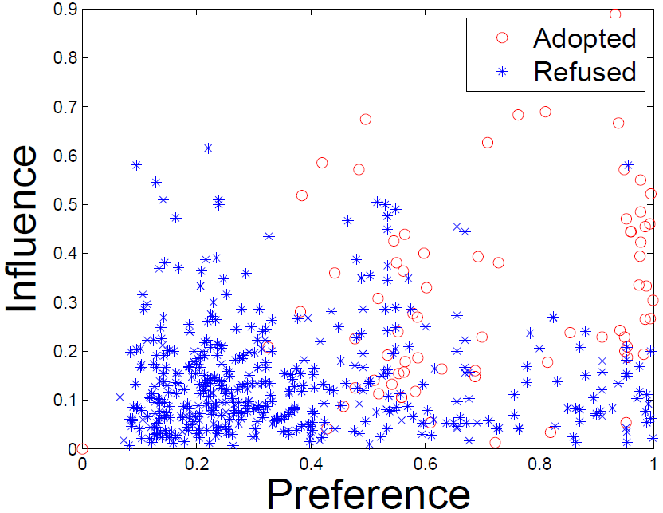
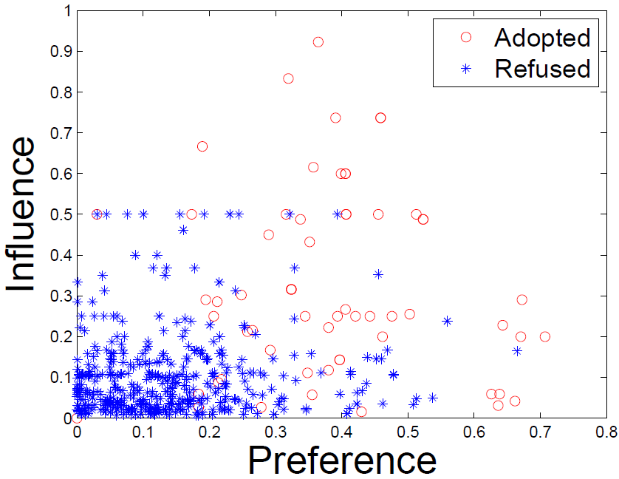
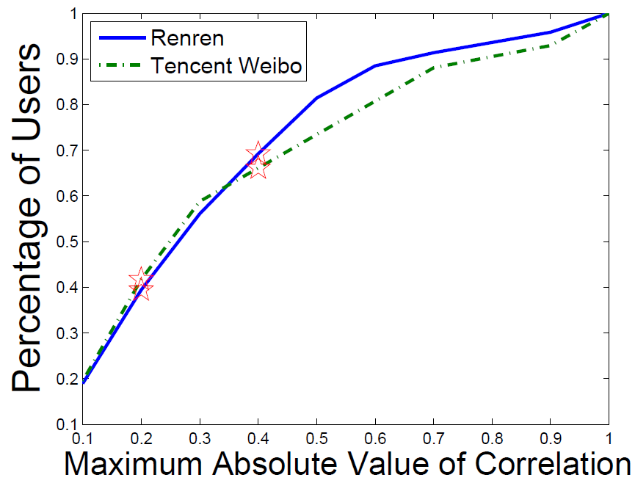
User Intention of Adopting Messages
What is the item content? Who is the sender?
Preference: topic-level user-item similarity
Influence: user-sender interaction frequency
Renren
Tencent Weibo
Correlation(Preference,
Influence) is small.

Slide 21
Outline
1. Background
2. Understanding Intention
3. The Framework
4. ContextMF Algorithm
5. Experiments

Slide 22
Social Contextual Information/Factors
item content
item latent feature V
user preference on given item
user-item interaction
user latent feature U
social relation
item sender G
social influence from sender of given item
user-user interaction
user-user influence S

Slide 23
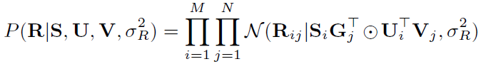
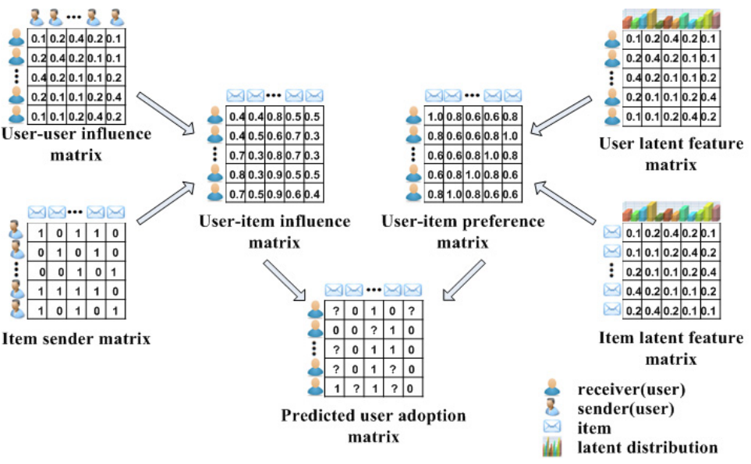
Social Contextual Recommendation
S
U
G
V
R

Slide 24
Outline
1. Background
2. Understanding Intention
3. The Framework
4. ContextMF Algorithm
5. Experiments

Slide 25
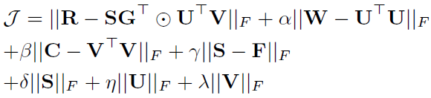
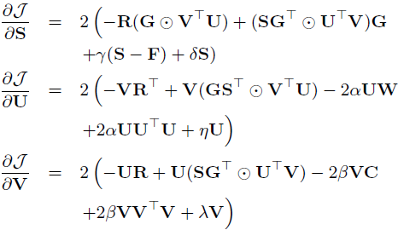
ContextMF Algorithm
Minimize sum-of-squared errors function
Block coordinate descent scheme with gradients.

Slide 26
Outline
1. Background
2. Understanding Intention
3. The Framework
4. ContextMF Algorithm
5. Experiments

Slide 27
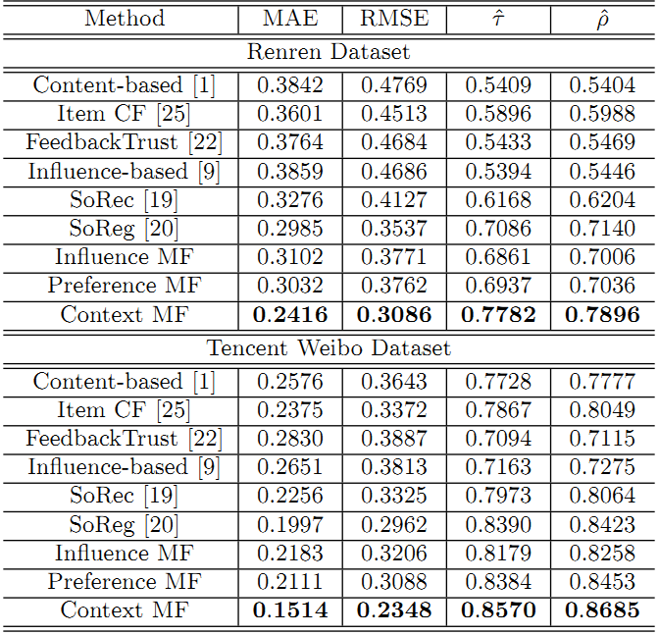
Effectiveness in Predicting Missing Links
 | Renren | Tencent Weibo
MAE | -19.1% | -24.2%
RMSE | -12.8% | -20.7%
Kendall’s | +9.82% | +2.1%
Spearman’s | +10.6% | +3.1%

Slide 28
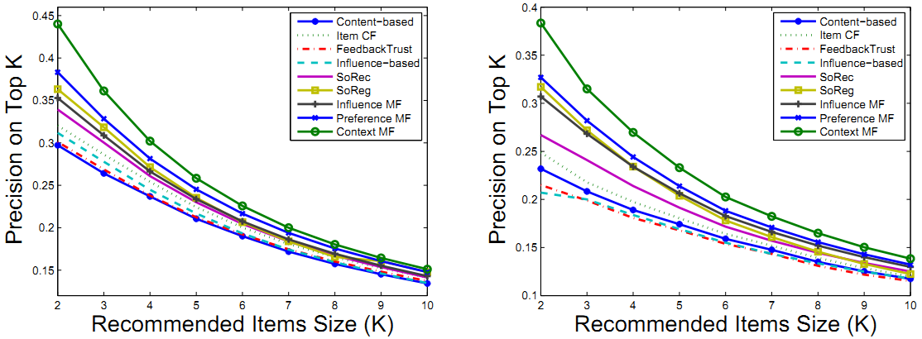
Effectiveness in Ranking Feeds/Tweets
ContextMF
ContextMF
Renren
Tencent Weibo
 | Renren | Tencent Weibo
Top-5 Precision | +21.7% | +12.3%
Top-10 Precision | +10.8% | +6.85%

Slide 29
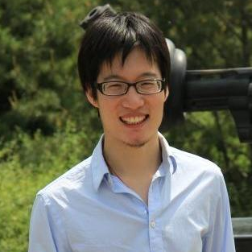
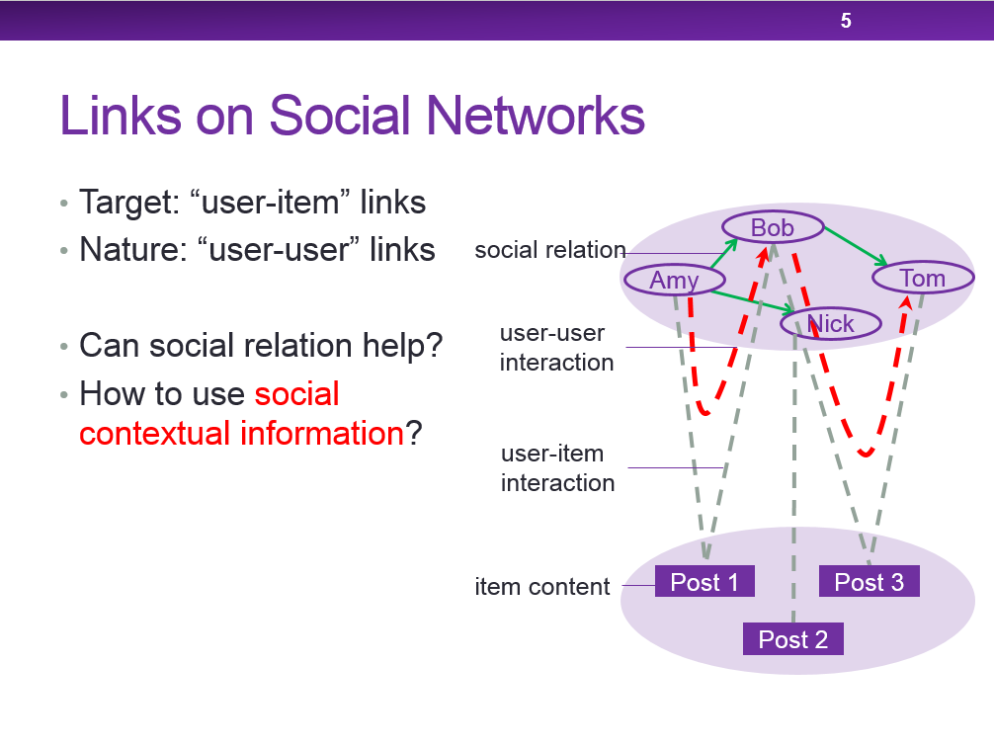
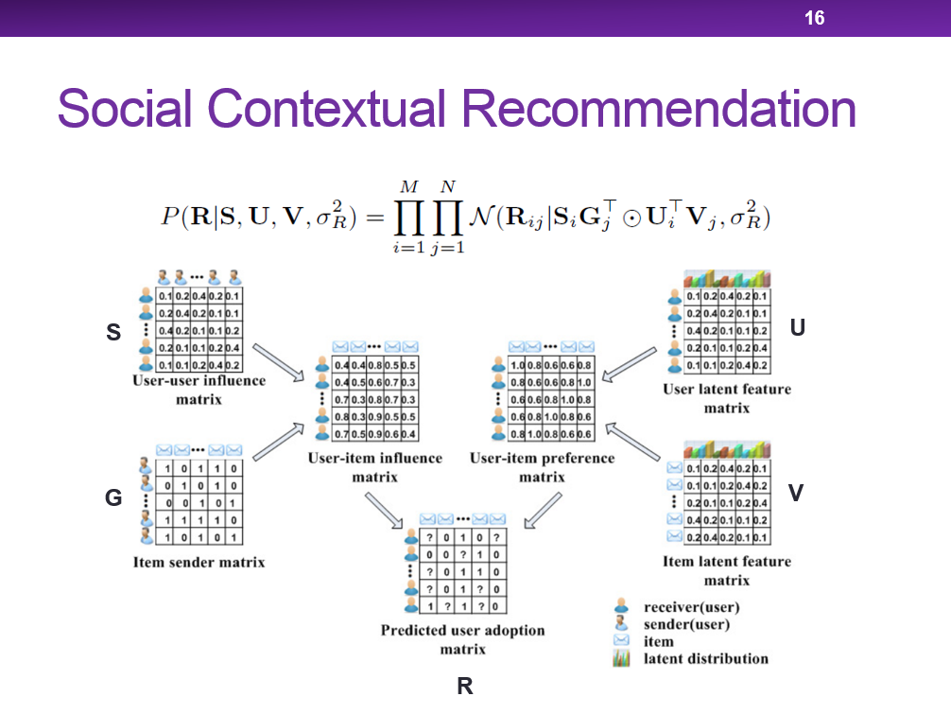
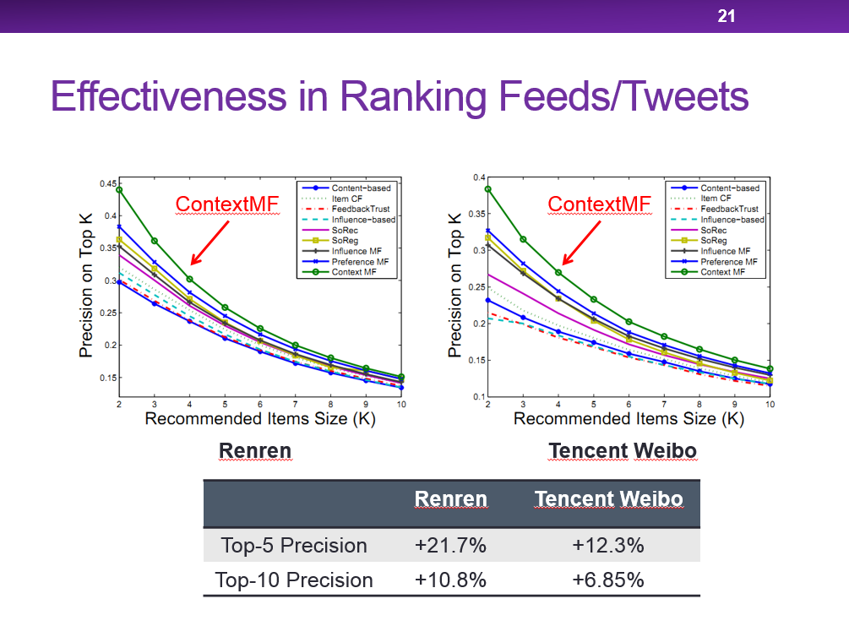
Questions?
Meng Jiang
mjiang89@gmail.com
http://www.meng-jiang.com

Slide 30

Scalable recommendation with Social contextual information
Meng Jiang
Joint work with Peng Cui, Fei Wang, Wenwu Zhu and Shiqiang Yang
TKDE 2014 (IF=1.815, 5-year IF=2.573)

Slide 31
Our Goals
Given: Links on social networks
Find: A social recommendation framework that fast and best fit adopting behaviors
Goals:
G1. Understand user intention of adoption
G2. A scalable framework for recommendation
G3. Fast predict the missing “user-item” links

Slide 32
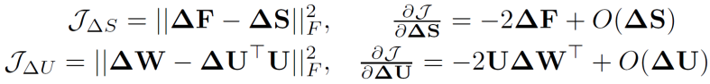
New Users Coming
 | Old N items | New ΔN items
Old M users | Done! O(k²L(M+N)²) | O(k²LΔNN) << O(k²LN(M+N))
New ΔM users | O(k²LΔMM) << O(k²LM(M+N)) | Sorry… Cold-start problem
item
user+new user
user+new user
^{adoption}
item
user
^{item content}
^{social relation}
interaction frequency
item
user+new user
user+new user
new user
?

Slide 33
New Items Coming
 | Old N items | New ΔN items
Old M users | Done! O(k²L(M+N)²) | O(k²LΔNN) << O(k²LN(M+N))
New ΔM users | O(k²LΔMM) << O(k²LM(M+N)) | Sorry… Cold-start problem
item
new item
item+new item
user
user
^{adoption}
?
^{item content}
^{social relation}
^{interaction frequency}
user
item+new item
user
user

Slide 34
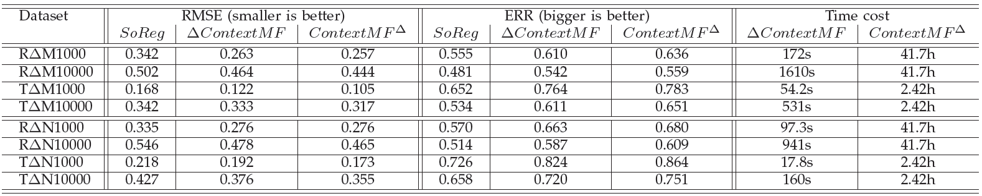
Efficiency in Incremental Data
Better than SoReg [Ma et al. WSDM 2011]
A little bit worse than offline learning (re-training)
Save time from hours to minutes when (M,N ~ million) and (ΔM,ΔN ~ thousand)

Slide 35
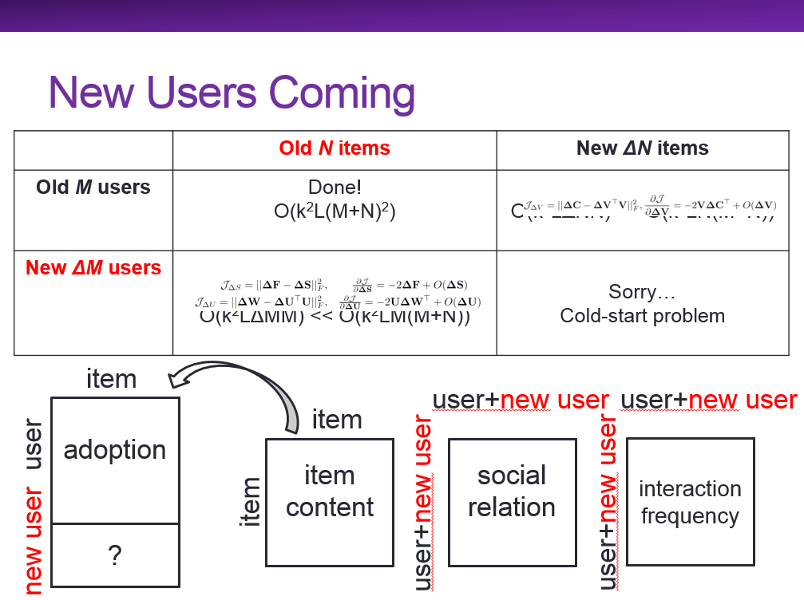
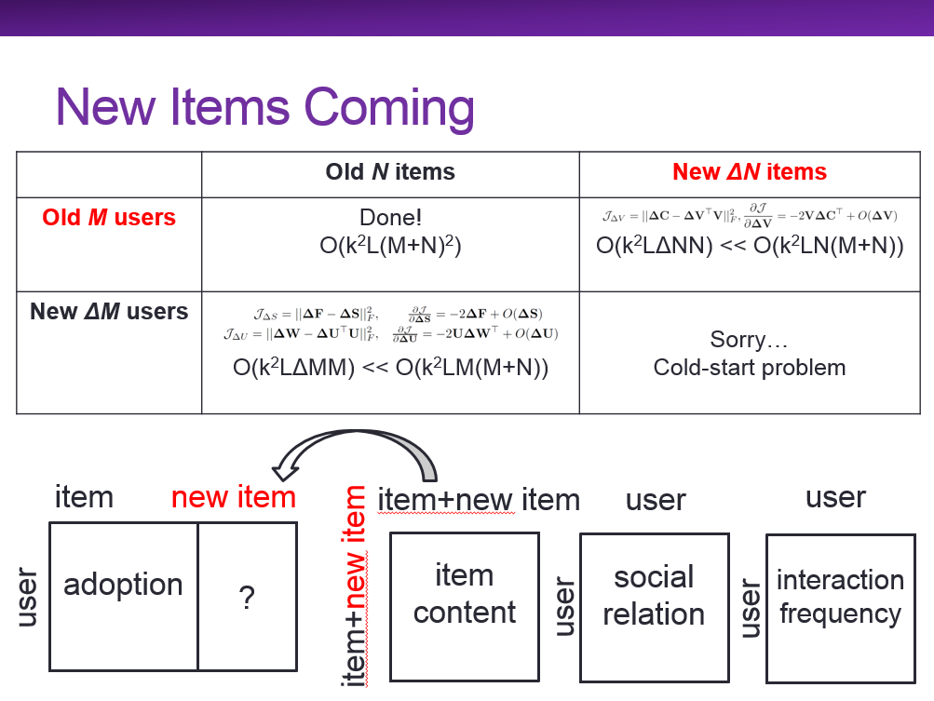
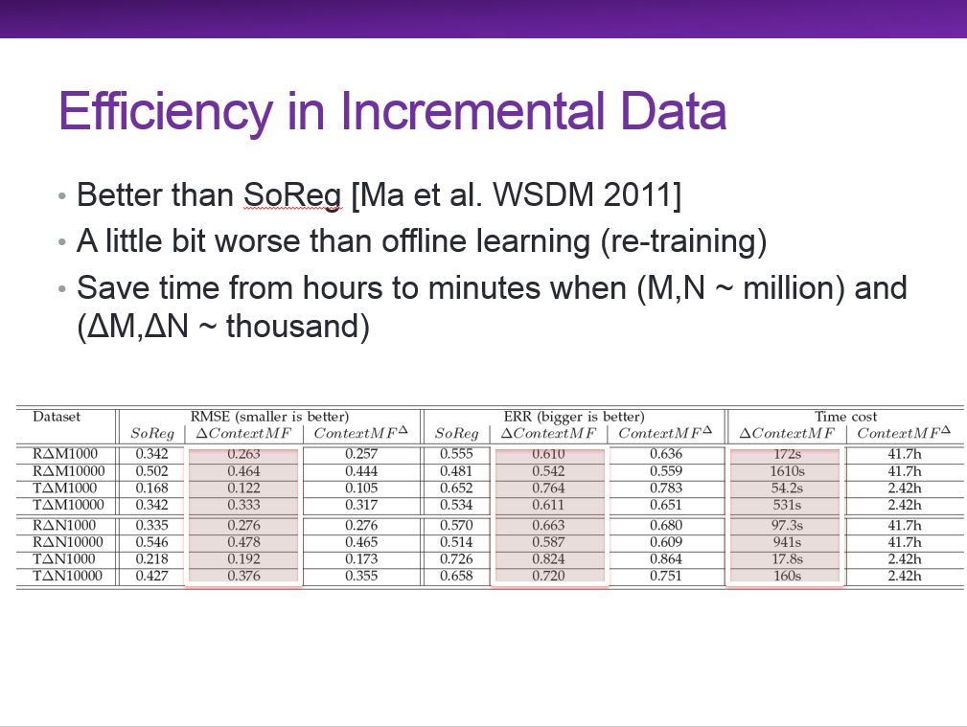
Questions?
Meng Jiang
mjiang89@gmail.com
http://www.meng-jiang.com

Slide 36
Normal Use + User-item Link
User-user link
User-item link
Normal use
Abnormal use

Slide 37
Social recommendation across multiple relational domains
Meng Jiang
Joint work with Peng Cui, Fei Wang, Qiang Yang,
Wenwu Zhu and Shiqiang Yang
November 1, 2012 – Maui, HI, USA

Slide 38
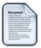

Recommender Systems
Predict missing “user-item” links
Challenge:
Cold-start and extremely high sparsity
cold-start
new user
web posts
?
users
?
high sparsity

Slide 39
Outline
1. Background
2. The Framework
3. HRW Algorithm
4. Experiments
5. Insights

Slide 40
Multiple Domains
User label domain
Choose < 10 from 200+ labels like ‘iPhone fan’
Peng Cui
Haidian, Beijing
Company: Tsinghua
User labels (5)
Tsinghua, Ph.D., World Wide Web,
Social Network, Social Media
Meng Jiang
Haidian, Beijing
University: Tsinghua
User labels (9)
Chinese food, World Wide Web,
Social Network, Data Mining, Liverpool Football Club, NBA, Humors, Sports, Ph.D. Candidates

Slide 41

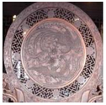

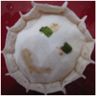
Multiple Domains
Interest group domain
Interest Groups (2)
Interest Groups (3)
Tsinghua University
I love sing!
Tsinghua University
Social Media & Reputation
World Wide Web Team

Slide 42
Our Goals
Given: Links on social networks
Find: A framework that use auxiliary knowledge in multiple domains to best predict “user-item” (target) links when the training set is too small.
Goals:
G1. Understand link formations on social networks
G2. A social network framework with multiple domains
G3. Solve the cold-start problem

Slide 43
Challenges: Multiple Domains
Relational
Within-domain links and cross-domain links
Heterogeneous
Different types of item domains
Sparse
Different sparsity levels

Slide 44
Outline
1. Background
2. The Framework
3. HRW Algorithm
4. Experiments
5. Insights

Slide 45

Reframe Social Networks
We have user-user, post-post and label-label links (social relation + item similarity).
web posts
users
user labels

Slide 46
Reframe Social Networks
We have user-post and user-label links.
web posts
users
user labels

Slide 47
Reframe Social Networks
No relations between item domains.
No post-label links in nature.
web posts
users
X
user labels

Slide 48
Reframe Social Networks
Stronger social relations help collaborate user-item links.
web posts
users
?
?
user labels

Slide 49
Reframe Social Networks
More collaborating in user-item links strengthen the social relations.
web posts
users
?
user labels

Slide 50
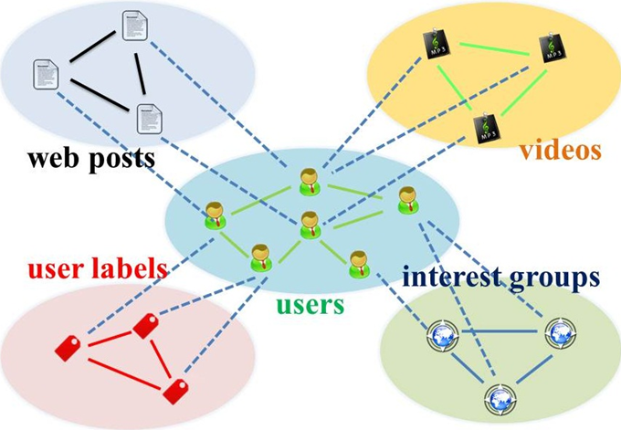
Star-structured Graph
Key idea: use “social relation” domain as bridge

Slide 51
Outline
1. Background
2. The Framework
3. HRW Algorithm
4. Experiments
5. Insights

Slide 52
Star-structured Graph
Method: Transfer learning + Random walk with restarts

Slide 53
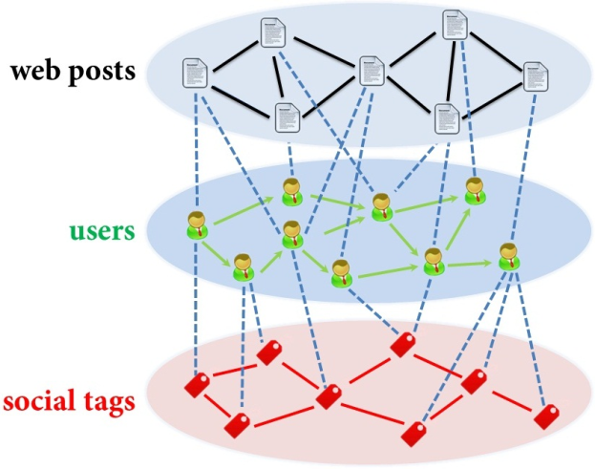
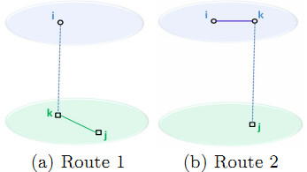
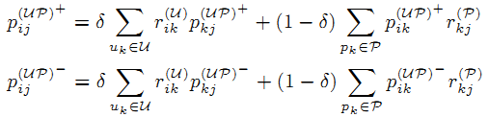
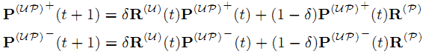
Hybrid Random Walk
On second-order star-structured graph
Update cross-domain links

Slide 54
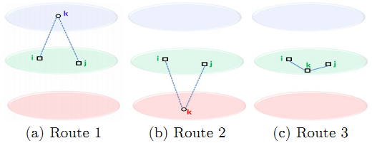
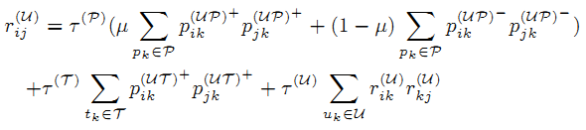
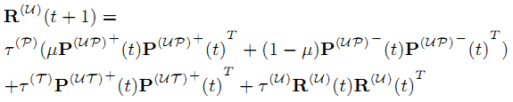
Hybrid Random Walk
Update within-domain links

Slide 55
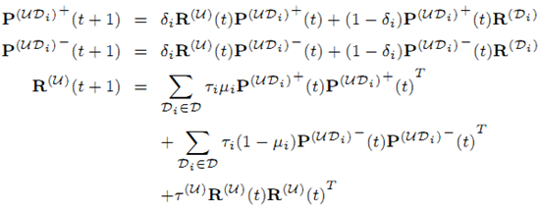
Hybrid Random Walk
On high-order star-structured graph

Slide 56
Outline
1. Background
2. The Framework
3. HRW Algorithm
4. Experiments
5. Insights

Slide 57
Data Set
Tencent Weibo (January 2011)
Domain | Size | Cross-domain links
 |  | Accept | Refuse
User | 53.4K | — | —
Web post | 142K | 1.47M (0.02%) | 3.40M (0.04%)
User label | 111 | 330K (5.57%) | —

Slide 58

Good to Transfer?
Comparative Algorithms (RWR)
W^{(P)} : Use web post similarity?
W^{(U)} : Use social relation?
R^{(U)} : Update tie strength?
W^{(T)} : Use user label similarity?

Slide 59


Good to Transfer!
Compare with RWR models
Compare with Baselines

Slide 60
Outline
1. Background
2. The Framework
3. HRW Algorithm
4. Experiments
5. Insights

Slide 61

Insights
If we do transfer (from user-label domain), we need only ~30% to reach the same performance.
Advice: build more apps for new users to give more info.
0 user-post
100% user-label
35% user-post
60% user-post
18% user-post
100% user-label

Slide 62



Questions?
Meng Jiang
mjiang89@gmail.com
http://www.meng-jiang.com

Slide 63
Normal Use + User-item Link
User-user link
User-item link
Normal use
Abnormal use

Slide 64



FEMA: Flexible evolutionary Multi-faceted analysis for dynamic behavior pattern Discovery
Meng Jiang
Joint work with Peng Cui, Fei Wang, Xinran Xu, Wenwu Zhu and Shiqiang Yang
August 25, 2014 – NYC, USA

Slide 65



Behavior Analysis
Modeling
How to formulate human behavior?
Pattern discovery
How to understand human behavior?
Prediction
What is the missing human behavior?
KDD’13
?
KDD’14

Slide 66
Our Goals
Given: Behavior data sequence
Find: A behavior analysis framework that fast and best discovers behavior patterns
Goals:
G1. Model the human behavior
G2. Understand the hidden patterns
G3. Predict the missing behavior

Slide 67
Outline
1. Background
2. Model Formulation
3. The Framework
4. Experiments
5. Visualization

Slide 68



Human Behavior - OLD
Write a paper
Post a Facebook message
+
+

Slide 69





Human Behavior: Multi-faceted
Write a paper
Post a Facebook message
{
+
}
+
+
{
+
}
+
+
+
+

Slide 70



Human Behavior: Dynamic
Write a paper
time
time
DB
time

Slide 71







Human Behavior: Dynamic
Post a Facebook message
Hour
talk
tea break
travel
sleep
time
Month
Tsinghua
WWW’14
Tsinghua
KDD’14
time

Slide 72
Human Behavior
Multi-faceted
Dynamic
How to model human behavior?

Slide 73
Outline
1. Background
2. Model Formulation
3. The Framework
4. Experiments
5. Visualization

Slide 74
Model Human Behavior
time
Human behavior
affiliation
keyword
author
Problem
Tensor sequence
Multi-faceted
Behavior modeling
Dynamic
Pattern discovery
Decomposition
Completion
Behavior prediction
≈
x
x

Slide 75
Challenges
High sparsity
High-order tensors
High complexity
Long sequence of tensors
Too slow if decomposing at each time
time
t₃
t₂
item
t₁
user

Slide 76
Idea
High sparsity
Auxiliary knowledge from regularizations
user
item
…
user
item
time
t₃
t₂
time
item
t₃
t₁
user
t₂
item
t₁
user

Slide 77
Idea
High complexity
Update projection matrices with new coming piece of data
user
item
…
user
item
time
t₃
t₂
item
item
time
t₁
user
user
t₁
t₂
t₃

Slide 78
Outline
1. Background
2. Model Formulation
3. The Framework
4. Experiments
5. Visualization

Slide 79
FEMA: Flexible Evolutionary Multi-faceted Analysis
0~t
Δt
0~(t+Δt)
X
+
ΔX
item
item
user
√
user
×
matricizing
update
item
cluster
λ
core tensor
X⁽¹⁾
user
cluster
user
decompose
user
cluster
X⁽²⁾
A⁽¹⁾
item
user
projection matrix
item
cluster
L⁽¹⁾
L⁽²⁾
user
item
A⁽²⁾
regularize
item
user
item

Slide 80

FEMA: Flexible Evolutionary Multi-faceted Analysis
0~t
Δt
0~(t+Δt)
X
+
ΔX
item
item
user
√
user
×
matricizing
update
item
cluster
λ
core tensor
user
cluster
Tensor Perturbation Theory
X⁽¹⁾
user
decompose
user
cluster
X⁽²⁾
A⁽¹⁾
item
user
projection matrix
item
cluster
L⁽¹⁾
L⁽²⁾
user
item
A⁽²⁾
regularize
item
user
item

Slide 81



FEMA Algorithm
Approximation
Bound Guarantee
core tensor
projection matrix

Slide 82
Outline
1. Background
2. Model Formulation
3. The Framework
4. Experiments
5. Visualization

Slide 83
Experiments: Test Behavior Prediction
Data sets
Leveraging multi-faceted information
Leveraging flexible regularizations
Efficiency, loss and parameters

Slide 84
Data Sets
Microsoft Academic Search
Subset of top 100 experts from query “data mining”
Paper: <author, affiliation and keyword>
Regularization: co-authorship <author, author>
7,777 x 651 x 4,566 x 32 years: 171,519 tuples
Tencent Weibo
43 days: Nov. 9, 2011 to Dec. 20, 2011
Tweet: <user-who-@, @-ed-user, word>
Regularization: social relation <user, user>
6,200 x 1,813 x 6,435 x 43 days: 519,624 tuples

Slide 85


Leveraging Multi-faceted Information
Predict “Who”-“What keyword”
FEMA uses “Where” (affiliation).
Predict “Who”-“@Whom”
FEMA use “What” (tweet word).
 | Microsoft Academic Search |  | Tencent Weibo
 | MAE | RMSE | MAE | RMSE
FEMA | 0.735 | 0.944 | 0.894 | 1.312
EMA | 0.794 | 1.130 | 0.932 | 1.556
EA | 0.979 | 1.364 | 1.120 | 1.873
Precision vs Recall
X
L
X
X

Slide 86


Leveraging Flexible Regularizations
“Who”-“Where”-“What keyword”?
“Who”-“@Whom”-“What”?
 | Microsoft Academic Search |  | Tencent Weibo
 | MAE | RMSE | MAE | RMSE
FEMA | 0.893 | 1.215 | 0.954 | 1.437
EMA | 0.909 | 1.466 | 0.986 | 1.698
DTA [Sun et al.] | 0.950 | 1.556 | 1.105 | 1.889
HOSVD | 1.047 | 1.618 | 1.220 | 2.054
CP | 1.055 | 1.612 | 1.243 | 2.117
Precision vs Recall
X
L
X

Slide 87



Efficiency, Loss and Parameters
Re-decompose
updated matrices
Insensitive to
regularization weight
Evolutionary analysis:
update λ and a with ΔX
Evolutionary analysis:
update λ and a with ΔX
Re-decompose
updated matrices

Slide 88
Outline
1. Background
2. Model Formulation
3. The Framework
4. Experiments
5. Visualization

Slide 89
Visualization: Test Pattern Discovery
Microsoft Academic Search
Tencent Weibo
Behavior Patterns
Multi-faceted
Dynamic

Slide 90

Microsoft Academic Search

Slide 91

Microsoft Academic Search

Slide 92

Microsoft Academic Search

Slide 93

Tencent Weibo

Slide 94

Tencent Weibo

Slide 95



Questions?
Meng Jiang
mjiang89@gmail.com
http://www.meng-jiang.com

Slide 96
Abnormal Use + User-user Link
User-user link
User-item link
Normal use
Abnormal use

Slide 97



Catchsync: catch synchronized behavior in large directed graphs
Meng Jiang
Joint work with Peng Cui, Alex Beutel,
Christos Faloutsos and Shiqiang Yang
August 26, 2014 – NYC, USA
Notes:
Hello everyone, welcome to listen to our work. My name is Meng Jiang. I am from Tsinghua University in Beijing. Our work’s title is CatchSync: Catch Synchronized Behavior in Large Directed Graphs. This is a joint work with Peng Cui and Shiqiang Yang from Tsinghua, and Alex Beutel and Christos Faloutsos from Carnegie Mellon University.

Slide 98










Fraud Detection: Graph Analysis Problem
[www.buyfollowz.org]
[buymorelikes.com]
Notes:
Fraud detection is an important problem for social networks. As the advertisements show here, there are some companies selling Twitter followers and Facebook “Likes” to inflate those numbers of their customers. How to catch the fraudsters can be considered as a graph analysis problem. We are looking for anomalous edges that are created by fraudulent behaviors instead of natural behaviors in the million-node graphs. For example, here we are trying to distinguish the botnets from the Simpson family.

Slide 99












Fraud Detection: Graph Analysis Problem
[buycheaplikes.com]
[reviewsteria.com]
Notes:
Similar things happen in YouTube and Amazon networks. The companies also sell YouTube Likes and 5-star reviews. How to find the videos which buy fraudsters to look popular can also be formulated as a graph analysis problem.

Slide 100
Our Goals
Given: A graph (large-scale, directed, etc.)
Find: Fraudulent behavior = Anomalous edges
Goals:
G1. Find patterns that distinguish fraudulent user behavior from normal behavior
G2. Design algorithms that catch fraudsters
Notes:
So here are our goals. Given us a graph. It could be very large. It could be directed or bi-partite. How can we find the fraudulent behaviors that create anomalous edges? Our goals towards this problem are: first, to find the patterns that can distinguish fraudulent behavior from natural behavior; second, understanding the patterns we can design algorithms that can catch the fraudsters.

Slide 101
Outline
1. Background
2. Fraudulent Pattern
3. The Algorithm
4. Experiments
Notes:
Here is the outline of this talk. First I will give the background. Then I will talk about the fraudulent patterns we discover. The third will be our CatchSync algorithm. And then I will give the experimental results. Let’s first take a look at the background.

Slide 102



Anomalies in Degree Distributions
Power-law distribution
DBLP Author-publication | Flickr User-user | Twitter Who-follows-whom
[konect.uni-koblenz.de/networks/]
Notes:
If there are fraudsters manipulating the social graphs, will the degree distributions show something strange? Let’s have a look at the out-degree distributions of these graphs. The figures are from a website in Germany called KONECT. The X-axis is out-degree, for example, how many publications an author has in DBLP. The Y-axis is the frequency of users. The figures are plotted in log-log scale. You can see the DBLP and Flickr networks show smooth power-law distributions. But the Twitter graph shows some spikes. There must be some anomalies.

Slide 103

Anomalies in Degree Distributions
2009
3.17M
0.41M
41M
d=20
Notes:
Let’s replot the distribution to make it clear. In the Twitter 2009 graph with 41 million nodes, we can see a spike of almost 3 million nodes in the out-degree distribution at degree 20. We can also see some other spikes.

Slide 104
Anomalies in Degree Distributions
2009
3.17M
0.41M
41M
d=20
Notes:
If we want to distinguish the accounts in Twitter that make those spikes, we just know some suspicious degree numbers, but there are still 0.41 million innocent people.

Slide 105
Linear Classifier with “Degree”: Fail
+1
(Fraud)
=20?
Label (+1,-1) | Out-degree
classifier
×
Notes:
If we build a linear classifier with the out-degree values to catch the fraud, it will fail. So the spikes can tell us the existence of anomalies but they cannot give us the way to catch them.

Slide 106


Anomalies in Degree Distributions
2011
1.91M
117M
0.44M
d=64
Notes:
The anomalies do not only happen on Twitter. In Tencent Weibo, a microblogging platform in China, we can also see spikes on its out-degree distribution.

Slide 107
Question 1: Spikes?
Is the million-user spike caused by natural or fraudulent behavior?
Notes:
So here we have the Question 1: Is the million-user spike caused by natural or fraudulent behavior? How to explain the spikes? If it shows frauds, how can we catch them?

Slide 108
Traditional Fraud Detection
+1
(Fraud)
Big?
Small?
Big?
Big?
Big?
Label (+1,-1) | Out-degree | In-degree | #tweet | #url in tweets | #hashtag in tweets
Content-based
features
classifier
Notes:
The traditional fraud detection methods are collecting a number of features of account and use supervised or semi-supervised algorithm to classify the account. For example, if a user has lots of followees, which means the out-degree is big, it has a high probability to be a fraudster. Other clues can be a small number of followers and suspicious user generated content. If a user posts lots of tweets, lots of url links or lots of hashtags in his tweets, he is probably a fraudster or spammer.

Slide 109



Empty Profile?
Notes:
However, the fake accounts that are trying to inflate the number of followers or Likes are usually smart. See here is one of the fake followers bought by a scholar with 5 dollars. He shows it in his personal website for some study. It has lots of profile information with nice photo and nice self-introduction. It has only 17 tweets. There is no url and hashtag in the 17 tweets. With the content , it’s hard to say this account must be bad.

Slide 110



Few Followers?
Notes:
Here is another example. The name is very suspicious. It’s exactly a fraudster. It follows lots of Internet Marketers and shopping sites. But it looks popular. It has 344 followers. This big value of in-degree will make the linear classifier confused.

Slide 111



Many Followings?
Notes:
Should the fraudsters have a big value of out-degree? Here is an example. Its name is Buy_AB22, which is very suspicious. It has only 20 followers and zero tweet. The followees are book authors or Internet Marketers. But the classifier cannot work when the big out-degree assumption is wrong.

Slide 112
Question 2: Content Unavailable?
0, 0, 0… sorry
Label (+1,-1) | Out-degree | In-degree | #tweet | #url in tweets | #hashtag in tweets
Content-based
features
classifier
Notes:
So here is Question 2. If the content-based features are unavailable, how can we catch the fraud? If not the content, what patterns do the fraudsters have to show?

Slide 113
Question 3: Robust to Camouflage?
Author
Humor sites
Author
Journalist
Magazine
Story
Sports
Fun
Notes:
Another question is about the robustness. Let’s see some of the Buy_AB22’s followees. They are author, humor site, author, jouralist, magazine, story, sport star and fun. All of them have a big number of followers. Fake followers like Buy_AB22 could be smart. They can create extra links to popular people so that they get camouflage and look normal.

Slide 114




Question 3: Robust to Camouflage?
Target
Popular
camouflage
Random
camouflage
Notes:
For example, besides their targets or customers, they can follow President Obama as “popular” camouflage. They can also follow some random user like you and me for camouflage. The question is how can we give a fraud detection method that can be robust to the camouflage?

Slide 115
Questions
Spikes?
Content unavailable?
Robust to camouflage?
Catch patterns of fraudulent behaviors!
Notes:
Here we summarize the questions: How to explain the spikes? How to solve the fraud detection problem when the content is unavailable? How to give a robust method to catch the fraud? Our idea or answer is to understand what the fraudsters want to do. They want to create links with monetary incentives. So we should catch the patterns of this fraudulent behavior.

Slide 116
Outline
1. Background
2. Fraudulent Pattern
3. The Algorithm
4. Experiments
Notes:
Now let’s see what is the pattern of fraudulent behavior.

Slide 117
Behavior-based Features
Follower
behavior
Followee
behavior
≈
≈
Out-degree
1st left singular vector
(Hubness)
2nd left singular vector
…
In-degree
1st right singular vector
(Authoritativeness)
2nd right singular vector
…
Notes:
To understand the behavior patterns, we first collect some behavior-based features. The behaviors could be follower behavior when we focus on out-going links and followee behaviors when we focus on in-coming links. If we do SVD on the adjacency matrix, the out-going links give us left singular vectors and the in-coming links give us right singular vectors. Here we use the two basic features of each type of links: out-degree and hubness which is the 1st left singular vector for follower behavior, and in-degree and authoritativeness which is the 1st right singular vector for followee behavior.

Slide 118


Behavior-based Feature Space
Follower
behavior
Followee
behavior
Notes:
Then we can plot the feature space of follower behavior and followee behavior. These are heat maps. X-axis is singular vector and Y-axis is the degree. Red for large population and purple for small. We can see anomalies in these feature space though we cannot tell why. Next we will compare the fraudsters and normal users in these feature spaces so that perhaps we can explain the anomalies.

Slide 119




Fraudulent Behavior Patterns
Notes:
Here is a normal user created by someone in Tsinghua a few years ago. It’s not very active. It just follows 117 users. I guess it’s because of the Internet policy of Chinese government – Twitter is blocked. The right-hand is the feature space of followee behavior. Every dot is a followee. We will tag some followees of this account. First it follows Bill Gates. He has a big value of in-degree and authoritativeness.

Slide 120


Fraudulent Behavior Patterns
Notes:
It also follows CMU. CMU is here. The second triangle.

Slide 121


Fraudulent Behavior Patterns
Notes:
It follows an account called Shanch GUO who was an MBA in Tsinghua, but he has only 15 followers and he is here, the last one.

Slide 122

Fraudulent Behavior Patterns
Notes:
Let’s plot all the followees of Tsinghua. We can see they diverse in the feature space. Normal users usually follow some famous people and also they follow ordinary people like their friends, relatives or classmates.

Slide 123




Fraudulent Behavior Patterns
Notes:
Now let’s see the followees of Buy_AB22. The squares are their followees. They are very close to each other.

Slide 124

Fraudulent Behavior Patterns
Synchronized
Abnormal
Notes:
For better vision, we plot the feature space in Gray. The triangles are followees of Tsinghua, while the squares are followees of Buy_AB22. Now we can see the fraudsters are consistently connecting to similar people. We call it synchronized. The followees are very different from the majority in the network. We call it abnormal. These two are basic characteristics of fraudulent behavior patterns.

Slide 125
Outline
1. Background
2. Fraudulent Pattern
3. The Algorithm
4. Experiments
Notes:
Now based on the patterns, we can devise an algorithm.

Slide 126



Synchronicity and Normality
Synchronicity
Notes:
We give two group-level concepts, synchronicity and normality to describe user behavior patterns, when we are given a node-level feature space. Synchronicity is computed as average similarity between each pair in one’s followee set.

Slide 127

Synchronicity and Normality
Normality
Notes:
Normality is computed as average similarity between a followee and every single node in the feature space.

Slide 128

Synchronicity-Normality Plot
Notes:
Now we can plot the synchronicity and normality in the same figure. Every dot is a user as follower. Normal users like Tsinghua are in the densest part in synchronicity-normality plot. Fraudster like Buy_AB22 have very big synchronicity and very small normality because their behavior patterns are synchronized and abnormal.

Slide 129
Theorem
For any distribution, there is a parabolic lower limit in the synchronicity-normality plot.
Proof. See our paper ☺
synchronicity
normality
Notes:
About the synchronicity-normality plot, we give a theorem to prove the lower limit in our paper. It is parabolic. The real data shows exactly a parabola on the lower bound.

Slide 130
CatchSync Algorithm
Fraudsters
Big synchronicity and small normality
Away from the densest
Distance-based
anomaly detection
method
Notes:
Now we can develop a distance-based anomaly detection algorithm to find fraudsters with big synchronicity and small normality and away from the densest. The algorithm is called CatchSync.

Slide 131
Outline
1. Background
2. Fraudulent Pattern Mining
3. The Algorithm
4. Experiments
Notes:
Now let’s see the experiments.

Slide 132
Experiments
Q1: Does CatchSync remove anomalies?
Degree distribution
Feature space
Q2: Is CatchSync catching actually fraudulent users?
Q3: Is CatchSync robust?
Notes:
In the experiments, we want to answer three questions: first, does CatchSync remove anomalies? We will check the degree distribution and feature space; second, is CatchSync catching actually fraudulent users; third, is CatchSync robust to camouflage.

Slide 133


Q1: Does CatchSync Remove Anomalies?
2009
3.17M
41M
0.41M
d=20
Notes:
How let’s see what we have after we remove anomalous edges caught by CatchSync from Twitter graph. The red curve is the updated degree distribution. It’s smooth and looks like power-law. From the results, we find around 3 million accounts consistently connect to 20 from a pool of 1,500 users who are Internet Marketers, shopping sites or financial groups who need a big number of followers.

Slide 134

Q1: Does CatchSync Remove Anomalies?
2011
117M
Notes:
We also can see the distribution is smoother on Tencent Weibo after CatchSync is performed.

Slide 135


Before CatchSync
Follower
behavior
Followee
behavior
Notes:
Also we check the feature space. Before CatchSync, we can see anomalies like stripes away from the major part.

Slide 136


After CatchSync
Follower
behavior
Followee
behavior
Notes:
After CatchSync, the stripes disappear. The suspicious accounts that we remove with CatchSync are exactly the anomalies in these feature spaces.

Slide 137
Q2: Is CatchSync Catching Actually Fraudulent Users?
173/1,000
237/1,000
Notes:
Second, we want to know if the users we caught are actually fraudulent? We random sample 1,000 account who have the degree values around the spikes. And then we ask 5 volunteers to take a look at their profiles to label them as fraudsters or normal users. They are fraudsters if at least 3 volunteers think they are. We have 173 fraudsters from Twitter data and 237 from Tencent Weibo.

Slide 138
Q2: Is CatchSync Catching Actually Fraudulent Users?
CatchSync
+SPOT
CatchSync
SPOT
OutRank
Notes:
Then we use random walk-based method OutRank, content-based method SPOT, and our method CatchSync to catch them. Our accuracy is 0.751 – much higher than others. If we blame fraudsters caught by either CatchSync for suspicious behavior or SPOT for suspicious content, we can have a better performance to 0.813.

Slide 139
Q2: Is CatchSync Catching Actually Fraudulent Users?
CatchSync
+SPOT
CatchSync
SPOT
OutRank
Notes:
On Tencent Weibo, CatchSync is also better than SPOT and the combination is much better. So our behavior-based method is better and complementary with content-based methods.

Slide 140


Q2: Is CatchSync Catching Actually Fraudulent Users?
Recall = 80% | Precision in Twitter | Precision in Tencent Weibo
 | 79.4% | 83.5%
Notes:
Also we give the precision-recall curves to further demonstrate our effectiveness.

Slide 141


Q3: Is CatchSync Robust?
Notes:
Third, is CatchSync robust to camouflage? We use synthetic data to test this. First we generate a random power-law graph and then inject synchronized behaviors on it. We can see the followees are shown as outliers in the feature space. And we can catch the injected followers easily in synchronicity-normality plot.

Slide 142


Q3: Is CatchSync Robust?
Notes:
Then we make the injected folllowers to follow 10% more popular nodes and 10% more random nodes. The injected followees are not outliers now. They hide in the feature space. But our synchronicity-normality plot can still find the inject followers who have synchronized and abnormal behaviors.

Slide 143


Q3: Is CatchSync Robust?
Popular
camouflage
Random
camouflage
Notes:
We do experiments on the synthetic data to test the precision and recall when there are popular camouflage or random camouflage. Our CatchSync is close to the ideal and much better than other graph-based methods. So we claim that CatchSync is robust to camouflage.

Slide 144
Conclusion
Goals
G1. Find patterns that distinguish fraudulent user behavior from normal behavior
A1: Synchronized & Abnormal!
G2. Design algorithms that catch fraudsters
A2: CatchSync!
Remove spikes
Content free
Robust to camouflage

Slide 145



Questions?
Meng Jiang
mjiang89@gmail.com
http://www.meng-jiang.com
Notes:
That’s all. Thank you for listening. I am happy to answer your questions now.

Slide 146
References
Meng Jiang, Peng Cui, Alex Beutel, Christos Faloutsos and Shiqiang Yang. CatchSync: Catching Synchronized Behavior in Large Directed Graphs. The 20th ACM SIGKDD International Conference on Knowledge Discovery and Data Mining (KDD), 2014. (Oral, 14.6%, Best paper final list)
Meng Jiang, Peng Cui, Fei Wang, Xinran Xu, Wenwu Zhu and Shiqiang Yang. FEMA: Flexible Evolutionary Multi-faceted Analysis for Dynamic Behavioral Pattern Discovery. The 20th ACM SIGKDD International Conference on Knowledge Discovery and Data Mining (KDD), 2014. (Oral, 14.6%)
Meng Jiang, Peng Cui, Alex Beutel, Christos Faloutsos and Shiqiang Yang. Inferring Strange Behavior from Connectivity Pattern in Social Networks.The 18th Pacific-Asia Conference on Knowledge Discovery and Data Mining (PAKDD), 2014. (Oral and Long, 10.8%)
Meng Jiang, Peng Cui, Alex Beutel, Christos Faloutsos and Shiqiang Yang. Detecting Suspicious Following Behavior in Multimillion-Node Social Networks. The 23rd international conference on World Wide Web companion (WWW), 2014. (Poster)
Meng Jiang, Peng Cui, Fei Wang, Wenwu Zhu and Shiqiang Yang. Scalable Recommendation with Social Contextual Information. IEEE Transactions on Knowledge and Data Engineering (TKDE), 2014. (Regular, CCF A)
Meng Jiang, Peng Cui, Rui Liu, Qiang Yang, Fei Wang, Wenwu Zhu and Shiqiang Yang. Social Contextual Recommendation. The 21st ACM International Conference on Information and Knowledge Management (CIKM), 2012. (Oral, 13.8%)
Meng Jiang, Peng Cui, Fei Wang, Qiang Yang, Wenwu Zhu and Shiqiang Yang. Social Recommendation across Multiple Relational Domains. The 21st ACM International Conference on Information and Knowledge Management (CIKM), 2012. (Oral, 13.8%)
Lu Liu, Feida Zhu, Meng Jiang, Jiawei Han, Lifeng Sun, Shiqiang Yang. Mining Diversity on Social Media Networks. Multimedia Tools and Applications, 2012.
Lu Liu, Jie Tang, Jiawei Han, Meng Jiang, Shiqiang Yang. Mining Topic-Level Influence in Heterogeneous Networks. The 19th ACM International Conference on Information and Knowledge Management (CIKM), 2010.

Slide 147

Thank you!
www.meng-jiang.com
❤ Friend ❤ Discussion ❤ Collaboration

